Slide 1


Week 8 Java
By: Clayton oswald

Slide 2

Steps for Assignment
Created Table in Oracle
Created Web Project with JSP, XML and Beans
Linked Web Project With Tomcat and Oracle
Ran Project Through Tomcat Server
Localhost 8088
Tested inputs
Screenshot Results
Notes: Used Previous Version and added
some feature From before.

Slide 3
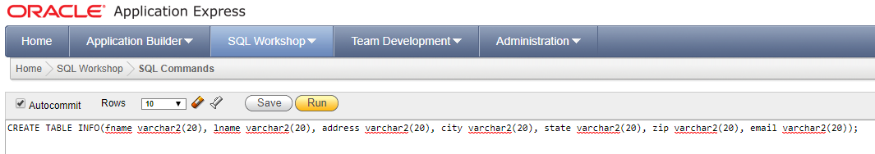
SQL Table
Used Same Table From Assignment 6.1

Slide 4
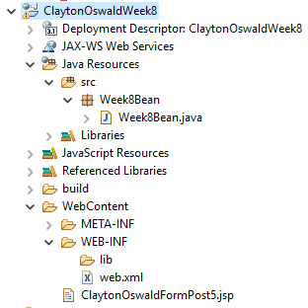
Project Layout
Very Similar to Assignment 7.1
Added Background Picture
Fixed bootstrap link
Found issue in bean.java creation that I fixed this week

Slide 5
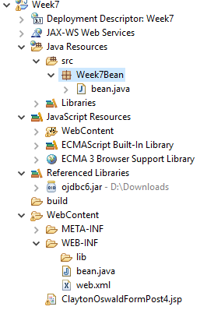
Fixes From Last Week
Added a new boot strap link that fixed how my text was centered and spaced. Overall it provided a much cleaner look.
Fixed issue with background from last week to make it look better than the green from before.
Lastly, I found that my DB name wasn’t working due to me bean.java file being in two places (see pics below)

Slide 6
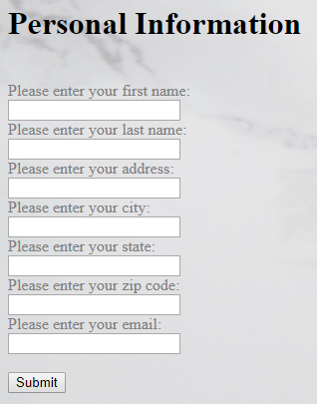
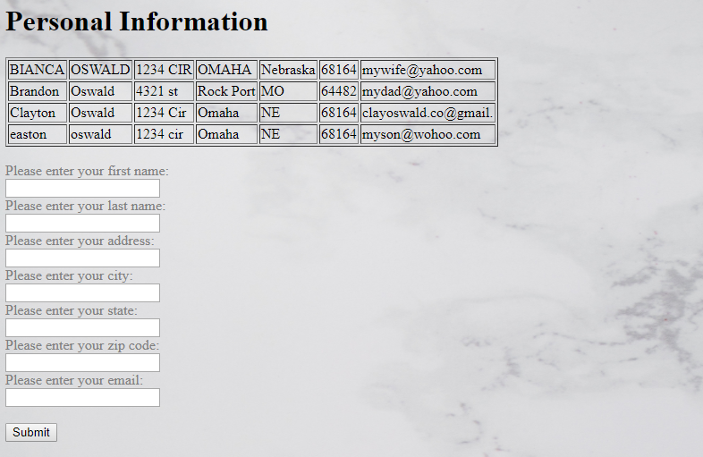
New Table Results

Slide 7

Thank You!

